Slide 1


GUREZ (J & K)
CHIEF OF THE ARMY STAFF
UNIT CITATION 2014
KANZALWAN - 2014

Slide 2


Slide 3



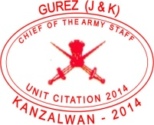

15 वीं बटालियन दि मराठा लाईट इन्फैन्ट्री (बुर्ज)
15TH BATTALION THE MARATHA LIGHT INFANTRY (BURJ)
BURJ
SARLA 2019-20

Slide 4







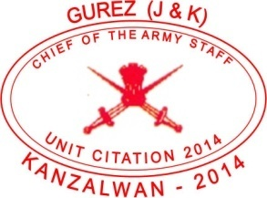

15TH BATTALION THE MARATHA LIGHT INFANTRY (BURJ)
AC
MVC
VrC
SC
BURJ
SARLA 2019-20

